Slide 1
BCBSMA Artificial Intelligence Strategy
May 2023

Slide 2
GENERATIVE AI is revolutionizing the entire healthcare ecosystem…
Human Intelligence Amplification
Artificial General
Intelligence
Generative AI – Chatbots & LLM
Impact
Robotics & Automation
NLP & Big Data Statistical learning
Deep learning- Image Processing
Generative AI is poised to cause significant disruption in healthcare
Rule-based decisions
Past
1990‘s
2000‘s
Now
2030‘s
2040‘s
Future

Slide 3





.. AND WILL IMPACT across our business functions
Domain | Functional Areas | High Impact Use Case (Illustrative)
Member Services | Contact Centre Enrollment and Billing | Conversational AI agents handle member inquiries with proficiency and empathy
Claims Management | Prior Authorizations Claims Auto-Adjudication Fraud, Waste, and Abuse | AI systems detect and flag fraudulent claims in real-time for investigation
Provider Relationship Management | Network Design Provider Engagement Value-Based Program Management | AI system selects providers based on quality, satisfaction, and cost
Healthcare Management | Care Management Quality Improvement Medical and Clinical Utilization Vendor Management and Optimization Contact and outreach optimization | AI algorithms identify risk factors, enabling proactive personalized care
Corporate Functions | Finance Talent management | AI identifies traits for better hiring decisions

Slide 4




Informed and Applied Faster learning and adoption cycles
BCBS MA BUILT WITH “AI INSIDE”
Rapid Business Proof Points Identify business use-cases, set-up sandbox and agile model
Relevant Investments Healthcare AI partnerships, technology alliances & skill development
Notes:
Our business fabric needs to have a strong AI enabled core so that we are ahead of our competition in navigating market shifts

Slide 5
Appendix

Slide 6












AI is at an inflection point with the breakthrough of generative ai, creating major implications FOR enterprise and society
Narrow AI (Rule-based, Speech)
Narrow AI – with Big Data
(B-2-C, Search, Ecommerce)
Democratization & Embodied AI
Generative AI
Collaborative AI on
new AI hardware
Artificial General
Intelligence
Deep Learning – Image Processing
NLP & Big Data Statistical learning
Brain-Computer Interfaces
Personalization: 76,897 micro-genres
Home & Service Robots
Man-Machine Collaboration
Handwriting & Voice Recognition
Self-driving vehicles
LLM based Chatbots
Neuromorphic Computing
Emotional Robots
Rule-based decisions
Past
1990‘s
2000‘s
Now
2030‘s
2040‘s
Future

Slide 7





WE have BEEN ON a Data and Analytics Journey for the Past 4 Years
2018
2020
2022
Established Enterprise Analytics Group
Aided critical member communication efforts during covid
TBD
Provided value in use cases across functions (marketing, care management etc.)
TBD
2019
2021

Slide 8







WIP
AI is making headway into every aspect of daily life and bcbs ma needs to act fast to stay competitive
Cigna Healthcare rolled out a patient health monitoring program through a virtual care platform to help patients by tracking their key biometrics giving patients better insights into their daily health
TBD
Anthem partnered with Google Cloud to create a synthetic dataset of medical data. This dataset will be used to train AI algorithms that identify fraudulent claims, abnormalities in human health records, etc.
TBD
Humana uses NLP, ML and RPA to allow their associates to have information instantly across multiple systems. The agent assist bot- provides patient information instantly reducing call transfers and wait times
Healthcare Management
Provider Relationship Management
Claims Management
Corporate Functions
Use of AI in healthcare
Member Services

Slide 9
AI is making headway into every aspect of daily life and bcbs ma needs to act fast to stay competitive
Domain | Examples of AI enabled use cases | Representative Future State
Member Services | Call center Enrollment and billing | Generative AI will automate routine tasks, offer personalized responses, and even simulate human-like conversations
Claims Management | Prior authorizations Claims auto-adjudication Fraud, waste, and abuse | Prior authorization workflow will be automated and expedited, leading to faster approvals and reduced administrative burden
Provider Relationship Management | Network design Provider engagement Value-based program management | Generative AI will revolutionize the way payers and providers interact, collaborate, and share information
Healthcare Management | Care management Quality improvement Medical and clinical utilization Vendor management and optimization Contact and outreach optimization | By analyzing patient data, including medical records & lab results generative AI will assist in developing tailored care plans based on individual needs
Corporate Functions | Finance Talent management | Screening process will be automated and candidate performance would be predicted based on historical data
Notes:
Member, claims, provider, healthcare, corp. -> example of future state

Slide 10
AI is at an inflection point with the breakthrough of generative ai, creating major implications FOR enterprise and society
Artificial General
Intelligence
Collaborative AI on
new AI hardware
Generative AI
Democratization & Embodied AI
Narrow AI – with Big Data
(B-2-C, Search, Ecommerce)
Narrow AI (Rule-based, Speech)
The advent of Generative AI is poised to cause significant disruption in the Payer Industry and the society in general
Past
1990‘s
2000‘s
Now
2030‘s
2040‘s
Future

Slide 11

Education
Educating business leaders on the latest advancements in AI enables them to take critical decisions that accelerate the organization’s growth in the right strategic direction
We need to plan forward and take steps to integrate AI into the organization’s core business processes
Proof of Concept
A PoC supports early-stage validation by giving the organization prototypes that align with the overall strategy before committing to a large-scale implementation, mitigating risks and ensuring a more successful outcome
Portal to aid Medicare plan comparison
Tool for contact center training
Tool to optimize medical policy
Investment
To pursue a successful AI implementation strategy, we need investments that can be used for hiring talent, upskilling existing employees and executing POCs listed above
Notes:
Cont. learning, increase speed of learning cycles

Slide 12






We need to take Immediate steps to integrate ai into the organization’s core business processes
Option 1
Investment
AI implementation requires investments in technology, talent and research
Proof of Concept
A PoC supports early-stage validation by giving users rapid access and allowing learning and iteration as efficiently as possible
Education
Portal to aid Medicare plan comparison
Learning about latest advancements in AI helps everyone speak a common language across teams
Tool for contact centre training
Tool to help optimize medical policy

Slide 13




WIP
AI is making headway into every aspect of daily life and bcbs ma needs to act fast to stay competitive
Fraud, Waste & Abuse: Anthem partnered with Google Cloud to create a synthetic dataset of medical data. This dataset will be used to train AI algorithms that identify fraudulent claims, abnormalities in human health records, etc.
Claims Adjudication
Aetna has created AI software to settle claims: Auto-adjudication of Complex Provider Contracts application — blends NLP and special database software to process claims and reduce rework costs
Provider Engagement: ‘MultiCare’ and ‘Coordinated Care’ use an AI driven solution designed to support collaboration between payers and providers by assigning medical necessity scores and assessing the anticipated levels of care for patients.
Healthcare Management
Call Center: Humana is using sentiment analysis and NLP to analyze transcripts from appeals calls. The company is learning the specific vocabulary model, patterns and sentiment from members in the past to present more creative solutions quickly
Claims Management
Provider Management
Corporate Functions
Member Services
Use of AI in healthcare

Slide 14





Immediate next steps to integrate ai into the organization’s core business processes
Option 2
Education
Proof-Of-Concepts (POC)
Investment
Learning about latest advancements in AI helps everyone speak a common language across teams
A PoC supports early-stage validation by giving users rapid access and allowing learning and iteration as efficiently as possible
AI implementation requires investments in technology, talent and research
Portal to aid Medicare plan comparison
Tool to help optimize medical policy
Tool for contact centre training

Slide 15
WIP
AI is making headway into every aspect of daily life and bcbs ma needs to act fast to stay competitive
Fraud, Waste & Abuse: Anthem partnered with Google Cloud to create a synthetic dataset of medical data. This dataset will be used to train AI algorithms that identify fraudulent claims, abnormalities in human health records, etc.
Claims Adjudication
Aetna has created AI software to settle claims: Auto-adjudication of Complex Provider Contracts application — blends NLP and special database software to process claims and reduce rework costs
Provider Engagement: ‘MultiCare’ and ‘Coordinated Care’ use an AI driven solution designed to support collaboration between payers and providers by assigning medical necessity scores and assessing the anticipated levels of care for patients.
Healthcare Management
Call Center: Humana is using sentiment analysis and NLP to analyze transcripts from appeals calls. The company is learning the specific vocabulary model, patterns and sentiment from members in the past to present more creative solutions quickly
Claims Management
Provider Management
Corporate Functions
Member Services
Use of AI in healthcare

Slide 16


We need to take Immediate steps to integrate ai into the organization’s core business processes
Option 1
Investment
AI implementation requires investments in technology, talent and research
Education
Proof of Concept
Learning about latest advancements in AI helps everyone speak a common language across teams
A PoC supports early-stage validation by giving users rapid access and allowing learning and iteration as efficiently as possible
Portal to aid Medicare plan comparison
Tool for contact centre training
Tool to help optimize medical policy

Slide 17

WE have made headways in ai adoption
Aided Critical Member Communication Efforts During Covid
Established the Analytics Enterprise Group
…
…
2018
2019
2020
2021
2022
2023
…
…
Proved Value in Key Use-Cases Across Functions
…
…
Notes:
Reduce text/box sizes – align text in an event format

Slide 18
WE have made headways in ai adoption
2018
2020
2022
Established Enterprise Analytics Group
Aided critical member communication efforts during covid
Proved value in use cases across functions (marketing, care management etc.)
2019
2021
Notes:
Here are the key points -1) establish enterprise analytics group - 2018 2) proved value in key use cases across functions ( marketing, care management, fraud,provider)3) during covid helped on critical member communication efforts-2020

Slide 19



AI is making headway into every aspect of daily life and bcbs ma needs to act fast to stay competitive
WIP
Domain | Description | Examples of AI enabled use cases | Potential impact on total mission value
Healthcare Management | Enhancing clinical and operational support to improve health outcomes | Care management Quality improvement Medical and clinical utilization Vendor management and optimization Contact and outreach optimization
Provider Relationship Management | Optimizing provider relationships to decrease spending and improve outcomes for members | Network design Provider engagement Value-based program management
Claims Management | Optimizing processes before, during, and after a claim is submitted | Prior authorizations Claims auto-adjudication Fraud, waste, and abuse
Member Services | Enhancing member and employer interactions with the organization | Call center Enrollment and billing
Corporate Functions | Managing back-office, administrative functions | Finance Talent management
Note:
“Total mission value” is defined as the combination of financial and non-financial factors, such as quality outcomes, patient safety, patient experience, clinician experience, and access to care (reference)
Notes:
Member, claims, provider, healthcare, corp. -> example of future state

Slide 20


Appendix
“Alignment Health is working at the forefront of the AI revolution in senior care with our own AI-powered technology that collects thousands of data points — from lab reports to whether a patient picked up their prescriptions on time — to get a holistic picture of a member's health.”
Language models have proven surprisingly good at bidirectionally generating structure from language, and language from structure. In our view, any place in healthcare where translation direction creates chaos is ripe for complete automation. For example, our claims system can now use understandable prose to explain why it paid a claim, or didn't.

Slide 21



Immediate next steps to integrate ai into the organization’s core business processes
Option 2
Education
Educating teams across different business functions will ensure that everyone speaks a common language and understands the latest advancements in AI
We will use generative AI to run the following POCs:
Portal to aid Medicare plan comparison
Tool to help optimize medical policy
Proof-of-Concepts (POC)
A PoC supports early-stage validation by giving users rapid access and allowing learning and iteration as efficiently as possible
Tool for contact centre training
Next steps:
Set up a sandbox
Investment
Run and test POC
AI implementation requires investments in technology, talent and research
Socialise results with leaders
Notes:
Portal to aid Medicare plan comparison
Tool to optimize medical policy
Tool for contract centre training

Slide 22





WE have made headways in ai adoption
TBD
Humana partnered with IBM Watson to leverage IBM’s conversational artificial intelligence (AI) solution – that will assist Humana employees and call center personnel to accurately answer questions quickly – helping to free up more time
UnitedHealth Group’s virtual assistance platform uses conversational AI and enhanced agents that reroute calls to sufficient internal resources, collect and classify patient information, and offer services that bring down costs and improve patient service experiences
Clinical Decision Support
Resource Optimization
Virtual Care
TBD
Claims Adjudication
Population Health Management
Use of generative AI in healthcare

Slide 23
AI is making headway into every aspect of daily life and bcbs ma needs to act fast to stay competitive
BCBS MA
01
02
Competitors
Fraud Detection, PA Automation
Personalized Care, Predictive Care, Coding Accuracy, Member Experience,
Care Cost Reduction
Macro-environment
04
03
Healthcare Industry
Autonomous Systems,
Multi-modal learning, AI based Cyber Security
Blueprint for AI Bill of Rights, FDA Regulatory Action Plan

Slide 24








PAYERS across board are adopting ai across multiple use cases to improve outcomes and reduce costs
Clinical Decision Support
Claims Adjudication
Fraud Detection
Personalized Medicine
Virtual Care
Population Health Management

Slide 25
Immediate next steps to integrate ai into the organization’s core business processes
Option 1
Education
Proof-of-Concepts (POC)
Investment
Learning about the latest advancements in AI helps stakeholders:
Identify opportunities
Set realistic expectations
Evaluate risks
Building POCs before implementing full fledged projects allows organizations to:
Assess feasibility
Mitigate risk
Gain stakeholder buy-in
Justify investments
AI implementation requires investments in:
Technology infrastructure
Data acquisition
Talent acquisition and training
Research and development
Educating teams across different business functions ensures that everyone speaks a common language and understands the impact of AI on their respective roles
POCs should be designed to test not just how a technology works but also how successful the solution might be in delivering its business value
These investments are crucial to be better prepared to leverage future advancements and remain competitive in the long run. AI can deliver tangible financial benefits

Slide 26
Detailed Slides

Slide 27




Our competition in market is doubling down on their AI investments
AI-powered tool reduced emergency department visits and hospital admissions by 31% and 25% respectively, resulting in $4.4 million in cost savings
AI-powered fraud detection system reduced false positives by 40% and identified 67% more fraudulent claims, leading to $100 million in cost savings
AI-powered chatbot reduced customer service call volume by 50% & increased customer satisfaction by 20%, resulting in cost savings of $1.5 million in just 6 months
AI tool led to a 14% reduction in hospital admissions and a 6% reduction in healthcare costs, saving $2 billion over three years
Applying AI for Business
BCBS-NC lost the State Health plan account after 40 years to Aetna, it is likely that Aetna leveraged AI based pricing and discounting models based on transparency data​
BCBS-NC lost the State Health plan account after 40 years to Aetna, it is likely that Aetna leveraged AI based pricing and discounting models based on transparency data​

Slide 28





AI will help align to market shifts & accelerate realization of our strategy
Our Corporate Strategy Pillars
Our Metrics
Affordability
Net Income
Business Powered AI Products
Operating Income
Experience
Medical Loss Ratio
Membership
Data
Tech
Digital
Risk-Based Capital
Equity
Diversified Product Sales
Operational Metrics
Quality

Slide 29


The entire healthcare journey of a patient will be driven by AI going forward
Sarah experiences frequent thirst, increased urination, unexplained weight loss, and fatigue and is alerted by her wearable device about the risk of diabetes
Sarah schedules an appointment with an endocrinologist
Endocrinologist utilizes AI-assisted diagnostics and diagnoses her with Type 2 diabetes, develops a treatment plan focusing on lifestyle modifications and medication management
Payer’s AI platform integrates with EHRs to support evidence- based treatment decisions
Payer receives the alert data and leverages AI to proactively engage Sarah for diabetes risk management
Payer’s AI platform helps Sarah find in-network, quality-endorsed diabetes specialists
Sarah receives educational resources, tools, personalized tips for diabetes management, and reminders helping her stay on track
Payer delivers AI driven personalized coaching for diabetes management
Sarah uses AI-enabled devices to track blood sugar levels, physical activity, and health metrics
Patient and Provider Touchpoints
Payer’s algorithms monitor Sarah's progress and provide reminders for follow-up care
Patient and Payer Touchpoints

Slide 30



Our AI Strategy – Considerations, Capabilities, Challenges
Considerations
AI must create a competitive advantage for us
Invest in cutting-edge technologies aligned with business outcomes
AI is transformative, rewiring decision making and operations
Invest in human capabilities to integrate AI and drive market behaviors
AI Strategy
Capabilities
1. Business-focused AI product management
2. Next-gen tech stack and partnership ecosystem
3. Investment in data and AI governance
4. Redesigned learning and talent development approach
5. Updated SOPs for responsible AI usage
6. Evaluations to monitor impact of AI
Challenges
Leadership alignment and incentives for strategy execution.
Balancing speed to value with perfection.
Aligning skill development and resource allocation with aspirations

Slide 31











Consumers are driving innovation and development in the AI space Creating a drag effect on enterprise ai
Starbucks' AI-powered inventory management system helped the company save $50 million in food waste costs in 2018
Fraud reduction & tailored recommendations
Capital One's AI-powered fraud detection system helped the company save $200 million in 2019
Enterprise AI
Waste prevention & quicker delivery
UK's National Health Service (NHS), Babylon's AI-powered chatbot triage system helped reduce the number of patients seeking care at emergency departments by 40%
Consumer AI
Preventive Care
Hilton's chatbot implementation helped the company save $700,000 per year in customer support costs
Personalized Recommendations
Amazon's recommendation engine is estimated to generate 35% of the company's revenue
Quick redressal & cheaper travel

Slide 32









payers are struggling to Create a Today forward approach while modernizing the legacy systems, But they also need to actively plan for Future-Back Approach
Today
Tomorrow
Experience & trial and error-based care
Personalized Care
Physician uses AI to recommend personalized treatment plan
KPIs to track
Cost Savings: percentage reduction in hospital readmissions, the average cost per member per month, and the percentage of claims denied
Member Satisfaction: member satisfaction scores, the number of complaints received, and the percentage of members who renew their policies
Quality of Care: percentage of members who receive preventive care, the average length of hospital stay, and the percentage of members who receive care within a certain timeframe
Unnecessary treatments, higher costs, and lower patient satisfaction
Complex Phone Menus with long wait times
Virtual Assistants
Bots answer common questions, schedule appointments, and provide personalized recommendations
Frustration, long wait times, and delays in receiving care due to complex query redressal systems
Cure focus
Prevention focus
Patients wait until they develop symptoms before seeking medical care
Patient is alerted of risks of possible complications to take preventive action

Slide 33



Payers who are Embracing AI are Gaining a Competitive Edge While Those Resisting it are Falling Behind
AI
AI-powered tool reduced emergency department visits and hospital admissions by 31% and 25% respectively, resulting in $4.4 million in cost savings
AI-powered fraud detection system reduced false positives by 40% and identified 67% more fraudulent claims, leading to $100 million in cost savings
AI-powered chatbot reduced customer service call volume by 50% and increased customer satisfaction by 20%, resulting in cost savings of $1.5 million in just six months
AI tool led to a 14% reduction in hospital admissions and a 6% reduction in healthcare costs, saving $2 billion over three years
While use of AI has multiple advantages, not using AI can have significant business impact - Blue Cross NC lost the State Health Plan Account after 40 years to Aetna, which could have been potentially avoided by leveraging price transparency data and analytics​

Slide 34







AI will act as a bridge between firm’s existing data capabilities and consumer’s digital experiences
Sales Force
Data
Care Management
Data & Enterprise Systems
Tech Stack
Consumer Experience
Artificial Intelligence
Contact Centre
API
Virtual Care

Slide 35



The ai strategy has to Incorporate the Three Big S - SMART, SCALE, and SAFE - to Achieve Long-Term Success
SCALE
Manage claims processing, customer service, and providing personalized recommendations and support to members on a large scale
SMART
SAFE
Analyze large amounts of data, identify patterns, and make accurate predictions to improve healthcare outcomes and manage costs
Technology is transparent, explainable, and compliant with regulations to build trust across stakeholders
AI
Multiple payers have deployed such AI systems
UHG’s Optum IQ
Anthem’s Health OS
Humana’s Personalized Concierge

Slide 36
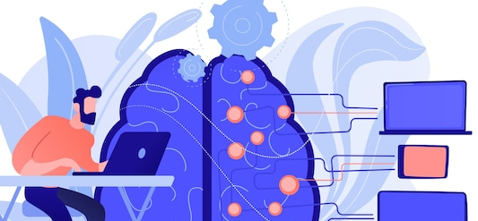
Integrating AI into Corporate Strategy for BCBS MA: Enhancing Customer Experience, Streamlining Processes, and Driving Revenue Growth
Customer Satisfaction
Revenue Growth
Compliance
Providing personalized recommendation
Faster claims processing
Proactive risk prevention
New Lead Generation
Auditing data usage
Cross Selling & Upselling
Encryption Enhancement
Access control monitoring
Optimizing Price & Discounts
Cost Reduction
Creating new features & functionalities
Discovering new opportunities
Accelerating R&D
Innovation
Automating Tasks
Improving Fraud Detection
Enhancing quality and improving efficiency
Supporting Foundation Implement chatbot, computer vision, and natural language processing for customer service and policy generation. Use machine and deep learning to personalize marketing, predict customer loyalty, and optimize pricing for revenue maximization.
Sources: 1. How insurers can win the race to AI maturity | Insurance Blog | Accenture
2. Insurance 2030—The impact of AI on the future of insurance | McKinsey
3. The Case for AI Insurance (hbr.org)
4. AI in Insurance Sector. How Is Artificial Intelligence Transforming the Insurance Industry? (nexocode.com)
Notes:
Talking points -
Implement a chatbot or virtual assistant to provide 24/7 customer service and support
Deploy a computer vision system to analyze images and videos for damage assessment and claim estimation
Use natural language processing to extract information from documents and contracts for policy generation and verification
Apply machine learning to segment customers based on their behavior, preferences, needs, etc. for personalized marketing and sales
Leverage deep learning to predict customer churn, retention, lifetime value, etc. for customer loyalty management
Employ reinforcement learning to optimize pricing and discounts based on customer demand, risk profile, market conditions, etc. for revenue maximization

Slide 37
AI's Three Ways of Relevance to Business: Driving, Going, and Integrating - How Payers like BCBS MA Can Benefit from AI
Improving operations
Enhancing efficiency & productivity
Improving customer satisfaction
Example - AI can optimize firm’s pricing, claims management, recommendations, customer service, and reduce costs and risks
Going with Business
Integrating with Business
Driving Business
Enhancing decision making
Enhancing collaboration
Enhancing creativity and learning
Example - Firms can use AI to enhance workforce capabilities and support strategic decisions based on data insights and forecasts
Using AI to create new sources of value and competitive advantage such as new products, services, markets or business models
Example - AI can personalize preventive care programs based on member health risks and preferences for firms
Sources: 1. How BCBS Massachusetts is using AI to fight fraud (beckerspayer.com)
2. BCBS of Massachusetts trims 8 days from prior auth time in AI pilot (beckerspayer.com)
3. BCBS of MA has new value-based contracts with equity metrics (fiercehealthcare.com)

Slide 38







AI is poised to transform consumer’s experience of interacting with the healthcare system
Chatbots and Virtual Assistants
Personalized Care
LLM powered virtual assistant helps manage appointments and reminders without paperwork or calls
Physician uses AI to recommend personalized treatment plan
KPIs to track -
Reduction in costs due to improved outcomes
Improvement in revenue per member due to uptick in retention
KPIs to track -
Reduction in admin costs
Improvement in revenue per member due to improved care
Increase in member satisfaction scores
Remote Patient Monitoring
Engagement & Medication Management
Physician recommends telemedicine appointment to discuss progress
24X7 chatbot to access information about health and treatment plan
KPIs to track -
Improvement in member satisfaction scores
Reduction in reimbursement costs
Reduction in overhead costs due to cancellations, etc.
KPIs to track -
Reduction in costs due to preventable hospitalizations
Improvement in revenue per member due to improved care
Increase in member satisfaction scores
Predictive Analytics
Analytics & Behavioral Health
Using AI physician recommends preventive measures & lifestyle changes to reduce risk
Physician uses EHR and patient behavior data to identify other health risks. Providers and payers prevent fraud
KPIs to track -
Reduction in costs associated with preventable hospitalizations
Improvement in risk adjustment and revenue management
KPIs to track -
Improvement in the accuracy and speed of diagnoses
Reduction in healthcare costs due to unnecessary diagnosis
Improvement in compliance with healthcare regulations

Slide 39








AI will act as a bridge between firm’s existing data capabilities and consumer’s digital experiences
Consumer Experience
Personalized recommendations
Predictive Analytics
Remote Patient Monitoring
Chatbots and virtual assistants
Electronic Health Records (EHRs)
Medication Management
Behavioural Health
Artificial Intelligence Layer
Enterprise Data And Analytics Systems
Notes:
Talking points – The impact of AI on the world, healthcare and healthcare insurance industry is interlinked. For example:
AI can help address the global health challenges posed by the COVID-19 pandemic by enabling rapid testing, tracing, diagnosis, treatment, vaccination, and research. AI can also help mitigate the social and economic impacts of the pandemic by supporting remote work, education, commerce, entertainment, and communication.
AI can help improve health equity and access by reducing disparities in health outcomes across different populations and regions. AI can also help increase health literacy and awareness by providing reliable information and guidance to individuals and communities.
AI can help foster collaboration and innovation in the health ecosystem by facilitating data sharing and analysis across different stakeholders, such as researchers, clinicians, patients, regulators, insurers, and policymakers. AI can also help create new business models and value propositions that benefit all parties involved.

Slide 40



WE have made headways in ai adoption
Establish Enterprise Analytics Group
Proved Value In Use-Cases
Helped in Critical Member Communication Efforts
Established the Enterprise Analytics Group in 2018
Proved Value in Key Use-Cases Across Functions Such As Marketing, Care Management, Fraud, Provider, etc.
Helped in Critical Member Communication Efforts During Covid in 2020

Slide 41
Executive summary
Artificial Intelligence (AI) is expected to have a significant impact on the broad economy (us, our members, customers, clinical partners, vendors, regulators) by transforming industries, creating new business models, and improving productivity and efficiency
These impacts include automation, personalization, innovation, job displacement and broader economic shifts
An AI strategy allows us to present our focus, choices, trade-offs, investments and impacts in a coherent way
Our AI strategy today is primarily inward focused (direct impacts of AI on our business), and will expand over time to also bring in indirect impacts to our business on account of AI driven transformation to our customers, partners, the broader state and national economy, etc.
There are 8 key components that we must succeed in for sustainable and impactful implementation of our AI strategy
Our objective today is to present where we stand against these 8 key components, our areas of focus and what levers we have available to accelerate favorable impacts from this transformational capability

Slide 42
BCBSMA’s Enterprise Artificial Intelligence (AI) Strategy
BCBSMA Artificial Intelligence (AI) Strategy is a combination of our advancing internal capabilities with cutting-edge external technologies to build market leading solutions, and create durable competitive advantage, by solving healthcare’s most intractable challenges
Our Data, Analytics, Automation, Cloud capabilities are foundational to such leverage
At BCBSMA, our Artificial Intelligence (AI) strategy is focused on leveraging cutting-edge technologies to drive affordability, improve quality and equity in healthcare, and enhance the overall consumer experience. We will achieve this by investing in research and development, partnering with leading AI vendors, and building a team of experts with deep expertise in machine learning, natural language processing, and computer vision.
Over time, likely all roles within BCBSMA practice AI-supported decision-making and execution, ranging from day-to-day actions to strategic decision-making
Build where advantage is clear; buy or partner for everything else

Slide 43








Key Components of BCBSMA’s Enterprise AI Strategy
For a successful, sustainable and impactful AI strategy implementation, there are 8 key areas of focus that we must succeed in to fully realize the benefits of this significant, societal step-change function
BCBSMA Enterprise AI Strategy
Data Strategy
Machine Learning Strategy
Solutions Roadmap
Talent & Skills
A plan for acquiring, storing, managing, and analyzing the data necessary to train AI models and develop AI-powered applications
Plan to develop, deploy, and maintain machine learning based models and applications
A detailed plan for executing the AI strategy, including timelines, milestones, and metrics for measuring success
A plan for acquiring, developing, and
retaining the talent and skills
necessary to build, deploy, and
maintain AI-powered systems
Governance /Risk Management
Infrastructure
Partnerships & Ecosystem
Continuous Learning
A framework for managing the ethical, legal, and regulatory risks associated with AI development and deployment, including data privacy, security, and bias
A plan for the hardware and software
infrastructure required to support AI
workloads, including data storage,
computing power, and networking
capabilities
A plan for building relationships with AI vendors, startups, research institutions, and other organizations to collaborate, share knowledge, and accelerate innovation
A commitment to continuously learning and improving AI capabilities through experimentation, feedback, and adaptation

Slide 44
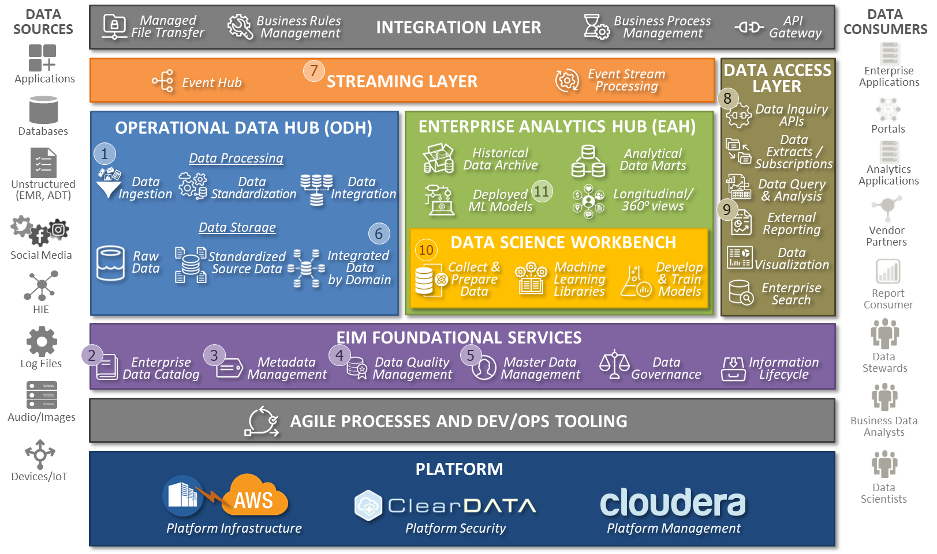




data strategy
A plan for acquiring, storing, managing, and analyzing the data necessary to train AI models and develop AI-powered applications
Data Strategy
Data Acquisition
Data Preparation
Data Storage
Data Governance
Sources and types of data that are required to train and validate AI models.
Transactional Data
Experience Data
Consumer Behavior Data
Socio-Economic Data
IoT Data
Processes to clean, transform, and normalize the data. Ensure that the data is in a format that can be used by AI algorithms and that it is tagged and labeled correctly.
Infrastructure required to store and manage large volumes of data, including the performance, scalability, and security requirements for data storage systems. Ensure that data storage is optimized for AI workloads, such as distributed file systems, and scalable storage solutions.
Policies and procedures for managing data security, compliance, privacy, and ethical considerations, including adherence to relevant regulations and guidelines, such as GDPR and CCPA. Establish roles and responsibilities for data management, including data stewards and data custodians.
What is it
Current
Upcoming
How @ BCBSMA

Slide 45
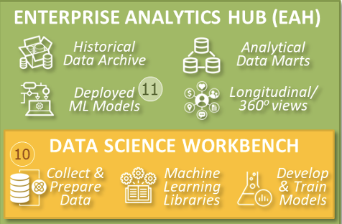




Machine learning Strategy
Plan to develop, deploy, and maintain machine learning based models and applications
Machine Learning Strategy
Algorithm Selection
Model Development
Model Deployment
Model Ethics
Choosing the right algorithms and techniques that are best suited to the specific business problem and data. Consider the trade-offs between accuracy, interpretability, and computational complexity.
Develop, train, and validate machine learning models using the selected algorithms and techniques. Use a combination of cross-validation, hyperparameter tuning, and other techniques to ensure that your models are accurate and robust.
Deploy machine learning models into production systems and applications. Integrate the models with other systems and data sources and ensure that they are scalable and reliable.
Policies and procedures for ensuring that machine learning models are developed and used ethically and responsibly. Ensure that we adhere to relevant regulations and guidelines. Establish roles and responsibilities for model governance and ethical considerations.
What is it
Current
Upcoming
Current
Upcoming
Current / Upcoming
Future
How @ BCBSMA

Slide 46
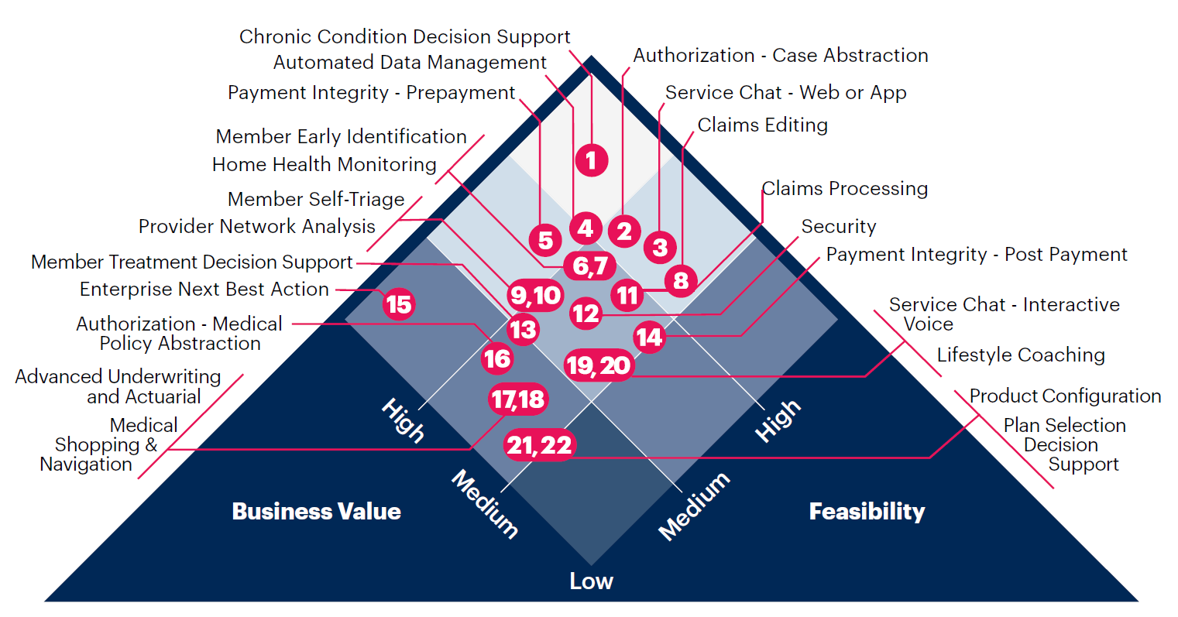


Solutions Roadmap
A detailed plan for executing the AI strategy, including timelines, milestones, and metrics for measuring success
Solutions Roadmap
Use Cases
AI Technologies
Model Development and Integration
Success Metrics
High-value, specific use cases focused on business problems that can be addressed using AI solutions, in alignment with our corporate strategy and business plan
Choose the appropriate AI technologies, including machine learning, natural language processing, computer vision, and other AI techniques, that are best suited to address the specific business problems. This includes assessment of build / buy / partner options
Develop, train, and validate AI models using the selected AI technologies using combination of supervised & unsupervised learning techniques to ensure that the models are accurate and reliable.
Integrate AI models into existing business processes, systems, and applications. Ensure that the models are scalable and can operate in production environments.
Individual and aggregate measurement of impact of AI models against key enterprise metrics (sales, revenue, margin, PMPM, Affordability, NPS, FCR/FCoR, Quality, Equity etc.)
What is it
Agile Analytics Pods
Enterprise Analytics Pods
Enterprise Technology Data & Analytics Pods
Enterprise KPIs
How @ BCBSMA
Business Function KPIs
Use Case KPIs

Slide 47

AI Prism – Healthcare Payers
Use Cases
We are leveraging a framework from Gartner that identifies the most impactful AI use cases across healthcare payer functions and scores each based on their respective business value and feasibility.

Slide 48
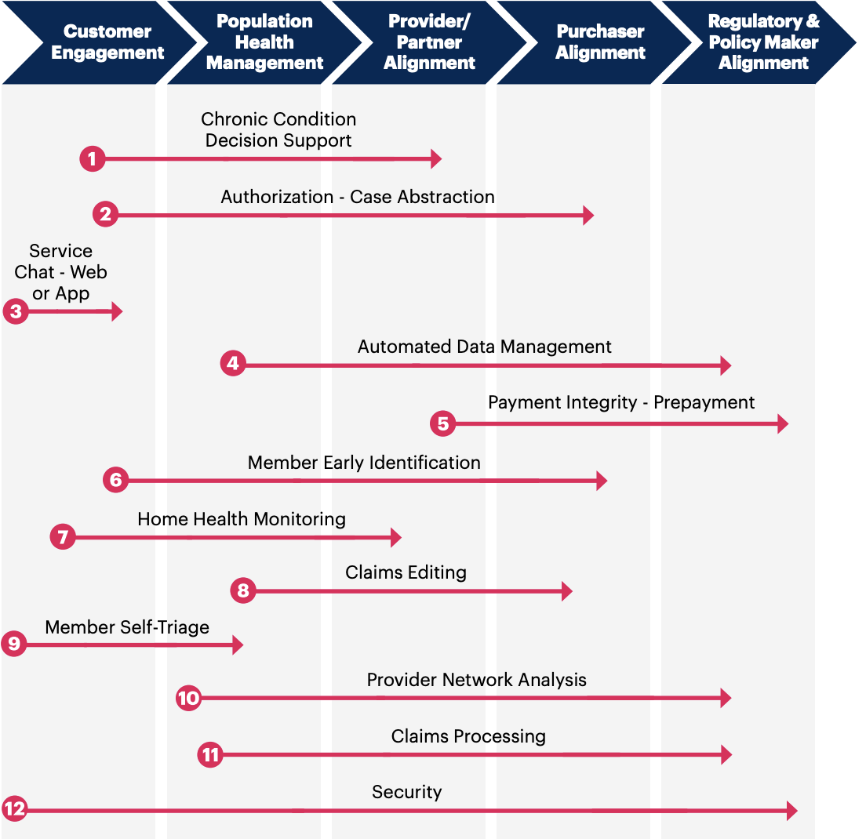

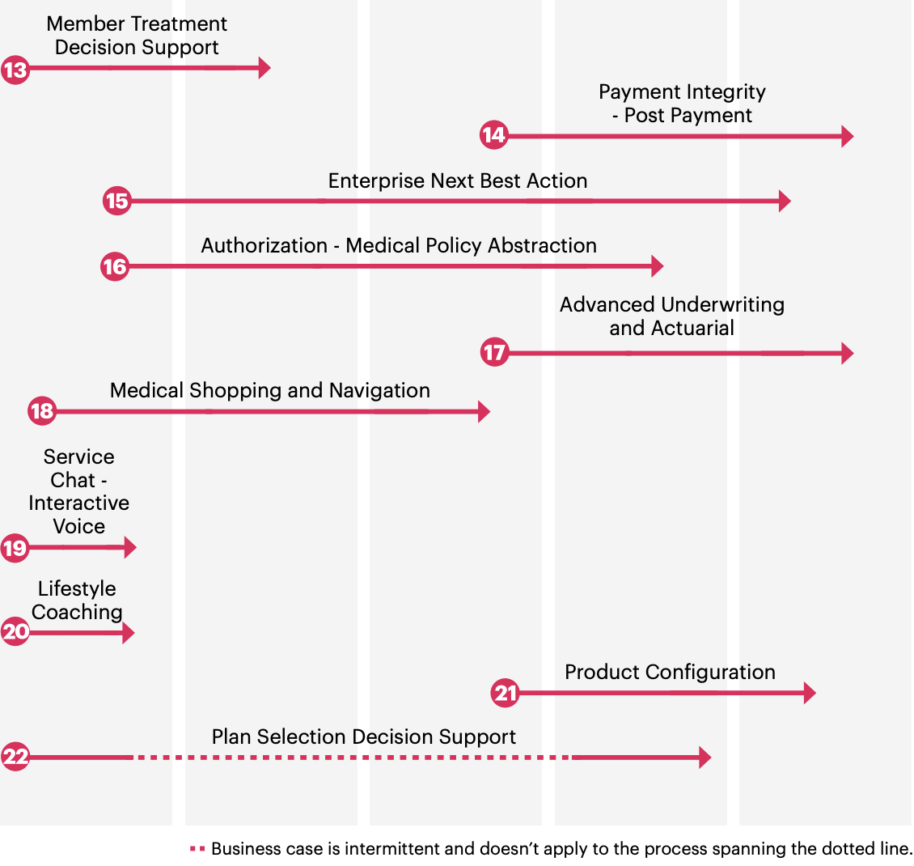
Use Cases
Expected impact of these use cases typically spans over more than one value area within BCBSMA. This allows for optionality of starting point (in alignment with our business plan) and leverage to adjacent areas of over time

Slide 49
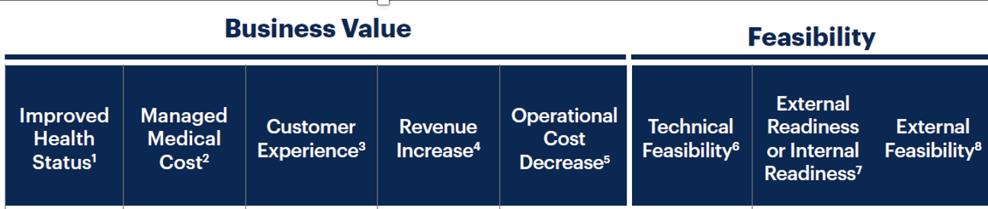
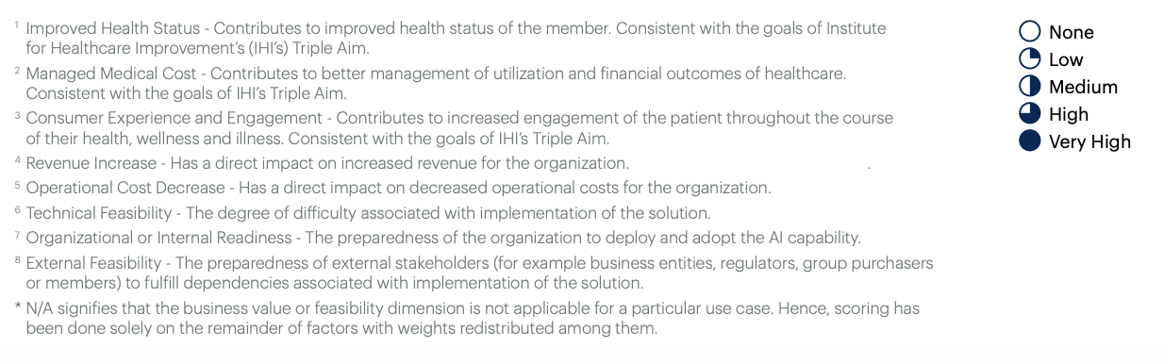
Evaluating AI use cases against our priorities, readiness and ongoing efforts
Are our Partners and Customers Ready?
How well do these efforts align to the full scope of AI use case
Business and Operating Model
Are We Ready?
Health Value Creation
How Hard?
Do we have any ongoing AI efforts?
BCBSMA Assessment
Owners
Current State @ BCBSMA | Alignment to Use Case Scope | Business Owners (Functions)

Slide 50
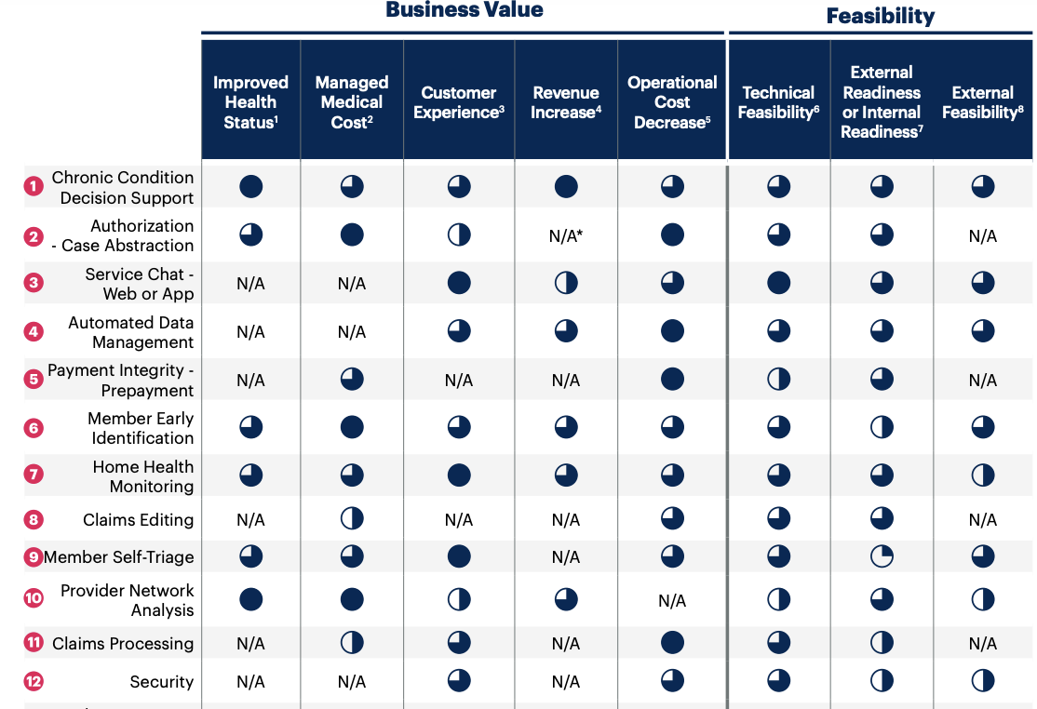








Use Cases (1 of 2)
We are leveraging a framework from Gartner that identifies the most impactful AI use cases across healthcare payer functions and scores each based on their respective business value and feasibility.
BCBSMA Assessment
Owners
Current State @ BCBSMA | Alignment to Use Case Scope | Business Owners (Functions)
 |  | PFH, HMM (Care Mgmt.)
 |  | HMM (Clinical)
 |  | Operations (MAPS)
 |  | EA, ET
 |  | Legal (FIP)
 |  | HMM (Clinical)
 |  | HMM (Clinical)
 |  | Operations (Claims)
 |  | PFH, HMM (Care Mgmt.)
 |  | Operations (Provider Mgmt.)
 |  | Operations (Claims)
 |  | Risk (Security)

Slide 51
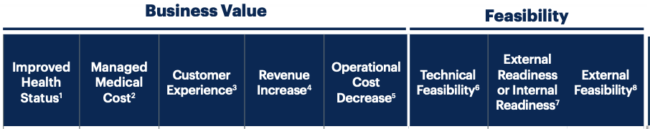
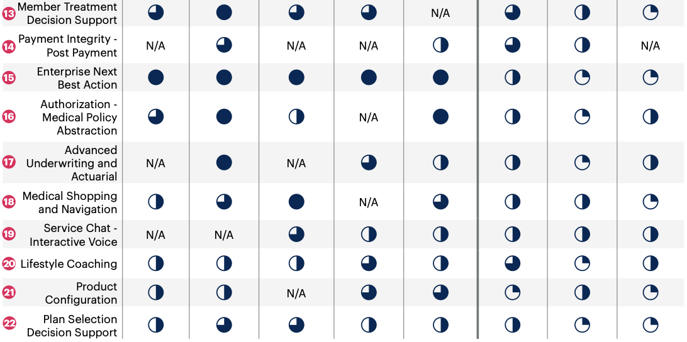
Use Cases (2 of 2)
We are leveraging a framework from Gartner that identifies the most impactful AI use cases across healthcare payer functions and scores each based on their respective business value and feasibility.
BCBSMA Assessment
Owners
Current State @ BCBSMA | Alignment to Use Case Scope | Business Owners (Functions)
 |  | PFH, HMM (Care Mgmt.)
 |  | Operations (Pymt. Integrity)
 |  | PFH, Ops (MAPS, Digital)
 |  | HMM (Clinical)
 |  | Finance (Underwriting)
 |  | PFH, Digital
 |  | Operations (MAPS)
 |  | PFH, HMM (Care Mgmt.)
 |  | Product
 |  | Product, Sales

Slide 52
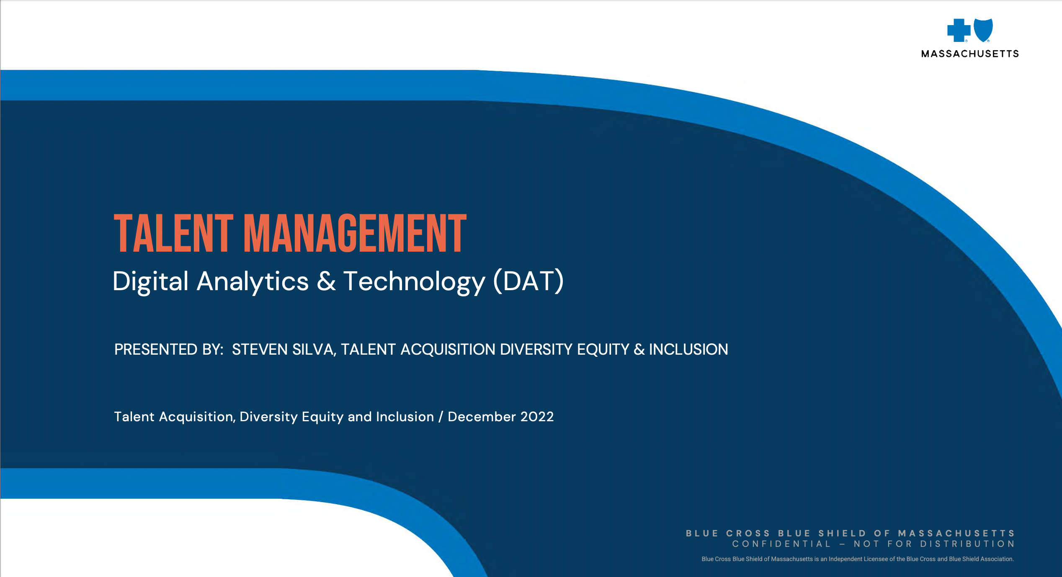

Talent and Skills
A plan for acquiring, developing, and retaining the talent and skills necessary to build, deploy, and maintain AI-powered systems
Talent and Skills
Define & Assess Skills
Hiring & Retention
Training & Development
Culture of Innovation
Identify specific skills, competencies and proficiency required for AI roles, such as data science, machine learning, natural language processing, and programming.
Assess the current skills of your workforce to identify gaps and areas for development.
Develop strategies to attract and hire top AI talent.
Develop strategies to retain and develop top AI talent.
Training and development plans to upskill and reskill employees to meet the required skill levels for AI roles. Use a combination of internal training programs, external courses and certifications, and on-the-job training to develop the required skills.
Establish a culture of innovation that encourages experimentation, risk-taking, and continuous learning. Encourage employees to share ideas and collaborate on AI projects to drive innovation and creativity.
What is it
How @ BCBSMA

Slide 53
Governance and risk Management
A framework for managing the ethical, legal, and regulatory risks associated with AI development and deployment, including data privacy, security, and bias
Governance & Risk Management
Governance Framework
Ethics and Training
Risk Assessment
Incident Response Plan
Roles, responsibilities, and processes required for effective AI governance. Establish a governance framework that ensures transparency, accountability, and compliance with relevant regulations and guidelines.
Develop ethical guidelines that provide clear guidance on the ethical use of AI. Consider issues such as fairness, transparency, accountability, and privacy.
Provide training and awareness programs to ensure that employees and stakeholders understand the ethical and responsible use of AI. Consider issues such as bias, privacy, and security.
Conduct risk assessments to identify and mitigate potential risks associated with AI solutions. Consider issues such as bias, discrimination, data privacy, and security. Develop risk management plans to address identified risks.
Establish an incident response plan that outlines the steps required to respond to incidents and breaches related to AI solutions.
What is it
Governance Forums
Enterprise Analytics EOG
DAL Steering Committee
Data Task Force
DAT Talent Committee
TBD
Enterprise Risk Management Framework
Enterprise Incident Response Management Framework
How @ BCBSMA

Slide 54
Infrastructure
A plan for the hardware and software infrastructure required to support AI workloads, including data storage, computing power, and networking capabilities
Infrastructure
Requirements Definition & Evaluation
Technology Selection
Security Measures
Monitoring
Define the infrastructure requirements for AI solutions, including hardware, software, and data storage. Consider issues such as scalability, performance, and availability.
Evaluate the existing infrastructure to identify gaps and areas for improvement. Consider issues such as compatibility with AI workloads, capacity, and performance.
Select appropriate technologies for AI solutions, including hardware such as GPUs and CPUs, software such as AI frameworks and tools, and data storage solutions such as databases and data lakes. Consider issues such as cost, compatibility, and performance.
Implement security measures to protect AI infrastructure from cyber threats. Consider issues such as access controls, encryption, and vulnerability management.
Implement monitoring and management tools to ensure the optimal performance of AI infrastructure. Consider issues such as real-time monitoring, automated alerting, and incident management.
What is it
Enterprise Infrastructure Management Framework
Enterprise Architecture and Technology Management Framework
Enterprise Security Management Framework
Enterprise Infrastructure Management Framework
How @ BCBSMA

Slide 55







Partnerships & Ecosystem
A plan for building relationships with AI vendors, startups, research institutions, and other organizations to collaborate, share knowledge, and accelerate innovation
Partnerships & Ecosystem
Potential Partner Identification
Partnership Establishment
Ecosystem Establishment
Collaboration
Identify potential partners that can support the AI strategy, such as technology vendors, data providers, and academic institutions. Evaluate potential partners based on their capabilities, experience, and reputation.
Establish partnerships with selected partners, such as technology vendors, data providers, and academic institutions. Define the terms and conditions of the partnership, including responsibilities, expectations, and benefits.
Establish governance and management processes to monitor and evaluate partner performance
Build an ecosystem that supports the development and deployment of AI solutions. Consider issues such as building a developer community, providing training and support, and promoting innovation.
Foster collaboration among partners to ensure the effective development and deployment of AI solutions. Establish communication channels and collaboration platforms to facilitate information sharing and collaboration.
What is it
How @ BCBSMA

Slide 56
Continuous learning
A commitment to continuously learning and improving AI capabilities through experimentation, feedback, and adaptation
Continuous Learning
Learning Objectives
Feedback Mechanisms
Evaluation and Refinement
Culture
Define the learning objectives for the AI solution, including improving accuracy, reducing errors, and enhancing performance.
Use transfer learning, reinforcement learning, and unsupervised learning.
Collect and analyze data to evaluate the performance of the AI solution. Use this data to identify areas for improvement and to generate feedback for the system.
Implement feedback mechanisms that enable the AI solution to learn from user interactions and to adapt to changing circumstances. Use techniques such as active learning, online learning, and semi-supervised learning.
Refine the AI solution based on the results of the monitoring and evaluation. Use techniques such as model tuning, feature engineering, and hyperparameter optimization.
Establish a culture of continuous learning within the organization. Encourage experimentation, collaboration, and knowledge sharing to foster a learning mindset.
What is it
How @ BCBSMA

Slide 57




AI Roadmap – what's next (1 of 2)
Current status and plan against the 32 focus areas for AI
 | Artificial Intelligence Focus Area | Initiate | Grow | Sustain | Collaborators*
Data Strategy | Data Acquisition
 | Data Preparation
 | Data Storage
 | Data Governance
Machine Learning Strategy | Algorithm Selection
 | Model Development
 | Model Deployment
 | Model Ethics
Solutions Roadmap | Use Cases
 | AI Technologies
 | Model Development and Integration
 | Success Metrics
Talent and Skills | Define and Assess Skills
 | Hiring and Retention
 | Training and Development
 | Culture of Innovation

Slide 58




AI Roadmap – what's next (2 of 2)
Current status and plan against the 32 focus areas for AI
 | Artificial Intelligence Focus Area | Initiate | Grow | Sustain | Collaborators*
Governance and Risk Management | Governance Framework
 | Ethics and Training
 | Risk Assessment
 | Incident Response Plan
Infrastructure | Requirements Definition and Evaluation
 | Technology Selection
 | Security Measures
 | Monitoring
Partnerships and Ecosystem | Potential Partner Identification
 | Partnership Establishment
 | Ecosystem Establishment
 | Collaboration
Continuous Learning | Learning Objectives
 | Feedback Mechanisms
 | Evaluation and Refinement
 | Culture

Slide 59
The ‘Ask’
Bellow are key areas where senior leadership support would go a long way is advancing our AI Strategy
Focus Area | Benefit to AI strategy
Strategic Funding | Accelerating Partnerships Removing initial build funding impediment for business teams Faster time to market
Dedicated AI-focused headcount and hiring | Create option for ’early draft pick’ Get the best talent in emerging space
Inclusion of AI adoption in key corporate metrics | Accelerate adoption of AI capabilities Outcomes orientation towards AI

Slide 60
APPENDIX

Slide 61
Use cases - Descriptions
# | Use Case | Description
1 | Chronic Condition Decision Support | An analysis of member data, plus IoT and event streams, focused on supporting daily decision making in living with a chronic disease.
2 | Authorization - Case Abstraction | A medical concept abstraction algorithm that reviews several sources that together represent everything available to the payer about the merits of an authorization request for a certain medical service. These sources may include structured fields in the submission workflow, as well as unstructured data in the form of PDF medical charts, lab reports, or correspondence.
3 | Service Chat - Web or App | A natural language interpretation and generation via a digital chat experience (web, app-based) to accomplish typical payer customer service needs (e.g., questions about a bill, requesting an ID Card, finding a doctor).
4 | Automated Data Management: | An automated analysis of data feeds from internal and external sources to ensure consistency and fidelity of payer enterprise data.
5 | Payment Integrity - Prepayment: | An analysis of a claim, prior to payment, to evaluate the likelihood that the claim is fraudulent. The output is a risk score that can be used to trigger an automated “pend” of a claim prior to payment.
6 | Member Early Identification | A medical concept abstraction from non-conventional payer data sources (such as consumer, wearable, unstructured clinical) with the aim of identifying intervention opportunities earlier than conventional sources would allow. Time-sensitive medical episodes like preference-sensitive procedures, high-risk maternity, and oncology can especially benefit from early identification.
7 | Home Health Monitoring | An analysis of member data, plus IoT and event streams, collected in the member home. Sources include wearables on the body, motion detectors in living spaces; and mechanical sensors for key activities like mattress compression, toilet utilization and refrigerator access. These signals are combined and analyzed to raise alerts that action should be taken to prevent or ameliorate adverse events.

Slide 62
Use cases - Descriptions
# | Use Case | Description
8 | Claims Editing | An automated data cleansing algorithm that runs after provider claims submission, but prior to payer adjudication of the claim. The algorithm is focused on ensuring a claim is ready for successful adjudication. The outputs are automated or suggested edits to the claim.
9 | Member Self-Triage | A predictive algorithm that analyzes presenting member information from a self-assessment, as well as existing medical and administrative data, to score various next steps in diagnosis, treatment or recovery (e.g., go to the emergency room versus using over-the-counter medication and monitoring).
10 | Provider Network Analysis | An analysis, sometimes using Graph, of the relationships between providers with regard to affiliations, facilities, referral patterns, cost, quality and experience measures to identify actions to optimize network performance.
11 | Claims Processing | An exception-based analysis of claims that are flagged for manual processing against how they are ultimately resolved. The output is analysis of claims processing exceptions that might be avoidable with changes in business logic or workflow.
12 | Security | An automated monitoring technology infrastructure for identification of perimeter vulnerabilities or active security threats.
13 | Member Treatment Decision Support | A matching algorithm that analyzes member information and preferences against available treatment pathways for a given health scenario. Studies have shown that providing members with evidence-based treatment options can improve health, financial and experiential outcomes.
14 | Payment Integrity - Post Payment | An analysis of a claim, after payment, to evaluate the likelihood that the claim is fraudulent. The output is a risk score that can be used by an investigations group to prioritize potential fraud cases. Recovering payments already made is uncertain and resource intensive.

Slide 63
Use cases - Descriptions
# | Use Case | Description
15 | Enterprise Next Best Action | A ranking algorithm that looks across all possible goals for a payer in relation to a member and scores them according to the predicted value of taking an action toward that goal. These goals may be administrative (e.g., policy renewal), clinical (e.g., engage in a care management program) or educational (e.g., learn to use the payer’s digital tools).
16 | Authorization - Medical Policy Abstraction | An analysis of sources, structured and unstructured, that collectively define the criteria used by the payer to determine whether a medical service will be authorized. This logic is often contained in structure branching logic described in internal PDF policy documents or licensed from third-party medical necessity content providers.
17 | Advanced Underwriting and Actuarial | A predictive model that anticipates aggregate medical costs across a line of business or other enumerated population for the purposes of business strategy, rate setting, or medical management strategy. AI techniques are often used in components (like natural language processing [NLP] of unstructured sources) and ensembled with more conventional actuarial models.
18 | Medical Shopping and Navigation | A matching algorithm that considers member needs and preferences for care (setting, convenience, timeliness, provider characteristics) against available medical service providers.
19 | Service Chat - Interactive Voice | A natural language interpretation and generation via a digital chat experience (voice; e.g., Alexa, Siri, Home) to accomplish typical payer customer service needs (e.g., questions about a bill, requesting an ID Card, finding a doctor).
20 | Lifestyle Coaching | An analysis of member data to determine and automate lifestyle related “nudges” toward better health behavior, especially as it relates to diet, physical activity and stress management.
21 | Product Configuration | An analysis to optimize the configuration of products, services, partnerships, programs and incentives for the purposes of aligning value between the payer and the purchaser (individual or employer).
22 | Plan Selection Decision Support | A matching algorithm that considers member preferences (like risk tolerance), medical risk, past utilization in ranking available health plan products.

Slide 64
Product and services offered by the EA and ET teams to advance our AI strategy
End-Use | Organization | Offering Type | Offering | Definition
Data as a Service (DaaS) | Data Solutions | Service | Data consultation / strategy | Helping end-users define how to organize and manage their data (e.g., Mental Health quality metrics)
 |  |  | Data ingestion | Ingesting / Extract Load Transform (ELT) new sources of data (internal / external) into consumable data sources
 |  |  | Data aggregation | Compiling data sources and organizing into consumable format
 |  |  | Data extraction | Retrieving data from data sources for further processing or storage
 |  | Product | Raw data | Data gathered from the source that has not been processed
 |  |  | Curated data | Organized and integrated data collected from various sources
 |  |  | Analytic engineering | Data modeled to provide clean, accurate datasets to end users
 | Data Management | Service | Data profiling | Examining, analyzing and creating useful summaries of data
 |  | Product | Data models | Models that help organize data and represent the connections between various data elements
 |  |  | Data catalogs / lineage | Catalogs that show calculation logic and source of information feeding data attributes
 | Data Governance | Service | Master data management | Repository of all data leveraged to create catalogs, CRUD processes, and bolster data-driven decision-making
 |  |  | Data quality | Cleansing, monitoring, profiling, matching, verifying, and enriching data quality for metrics/reporting (e.g., Provider)
 |  |  | Reference data | Controlled method to align patient data across the enterprise to a common frame of understanding
 |  |  | Meta data | Structured information that describes, explains, or locates data, making it easier to retrieve, use, or manage
Insights as a Service (IaaS) | Visualization Solutions | Service | Visualization consultation | Helping end-users decide how to consume data
 |  |  | Data mining / insights | Mining the data for insights that can help end-users with business decisions
 |  |  | Report development | Capturing requirements and developing reports and visualizations for end-users
 |  |  | Report maintenance | Helping maintain reports / visualizations (e.g., monitoring / preventing breaks, addressing fixes)
 |  |  | Visualization tool training | Training end-users to consume information (e.g., Enterprise Training)
 |  | Product | Reports | Consumable and organized information for specific consumption use cases
 |  |  | Visualizations / dashboards | Interactive views of information for specific consumption use cases (e.g., Mental Health dashboard)
 |  |  | Diagnostic / descriptive reports | Analytical models that use diagnostic / descriptive techniques to recommend outcomes
 | AI / ML Solutions | Service | AI / ML consultation | Helping end-users decide how to leverage advanced analytics
 |  |  | Model development / engineering | Capturing requirements and developing models for end-user consumption (e.g., FWA Scheme Detector)
 |  |  | Model maintenance | Productionalizing and maintaining models once they have been developed
 |  |  | Model integrations | Integrating models / model outputs with other applications
 |  |  | AI / ML training | Training end-users to leverage AI / ML tools and capabilities (e.g., Enterprise Training)
 |  | Product | Predictive/prescriptive models | Analytical models that use historical and current data to help predict future outcomes

Slide 65
Product and services offered by the EA and ET teams to advance our AI strategy
End-Use Type | Organization | Offering Type | Offering | Definition
Insights as a Service (IaaS) | Function- Specific Analytics | Service | Financial Analytics | Ad hoc analysis to answer specific business questions and forecast possible financial scenarios
 |  |  | Operational Analytics | Ad hoc analysis to answer specific business questions and enable operational insights
 |  |  | Call Center Analytics | Ad hoc analysis to answer specific business questions and enable call center insights
 |  |  | Human Resources Analytics | Ad hoc analysis to answer specific business questions and enable human resource insights
 | Statistical Analysis | Service | Financial Analysis | Process of evaluating financial information to reach business decisions
 |  |  | Actuarial Analysis | Process of evaluating the likelihood of risk based on statistical data
Platform as a Service (PaaS) | Platform Solutions | Service | Data platform management | Governing end user's integrated system that meets their end-to-end data needs
 |  |  | Visualization platform management | Helping end users maintain their unified solution that improves decision making based on data and analytics
 |  |  | AI / ML platform management | Curate and maintain the platform that helps accelerates AI / ML model development and deployment
 |  |  | Cloud platform management | Maintaining end user's cloud platform
 |  |  | Sandbox management | Provisioning and managing (e.g., security, access) sandbox environment
 |  | Product | D&A platform | Design and build an integrated platform across people, technology systems and information
 |  |  | Data sandbox | An environment for end-users to “play” with data and get quick insights to inform business ops.

